Slide 1

Presentation of Minor Project
DRONEHOUSE

Slide 2
Group Members
1. Jayant Bhardwaj (201500315)
2. Ajay Singh ( 201500049)
3. sakshi jain (201500608 )
4. Lakshya sharma (201500368 )
SUBMITTED TO :
Faculty name :
Ms.Ruchi Gupta
Senior Trainer

Slide 3
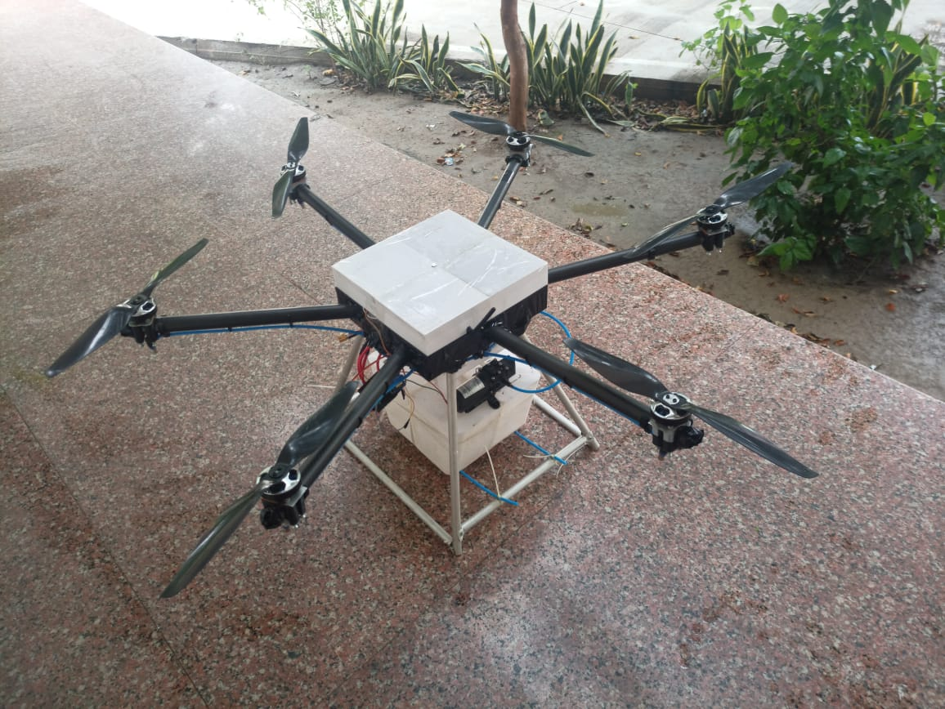
Our Taxonomy
“dronehouse” is named after drone technologies, that we want to create a house for drone and other aeriel technologies.so working upon these requirements we had this taxonomy “Dronehouse”.

Slide 4
What are we working upon :
1. Online Aeriel shop to guide the best drone according to need.
2. learning to make drones through our expert.
3. selling of other drone parts.

Slide 5
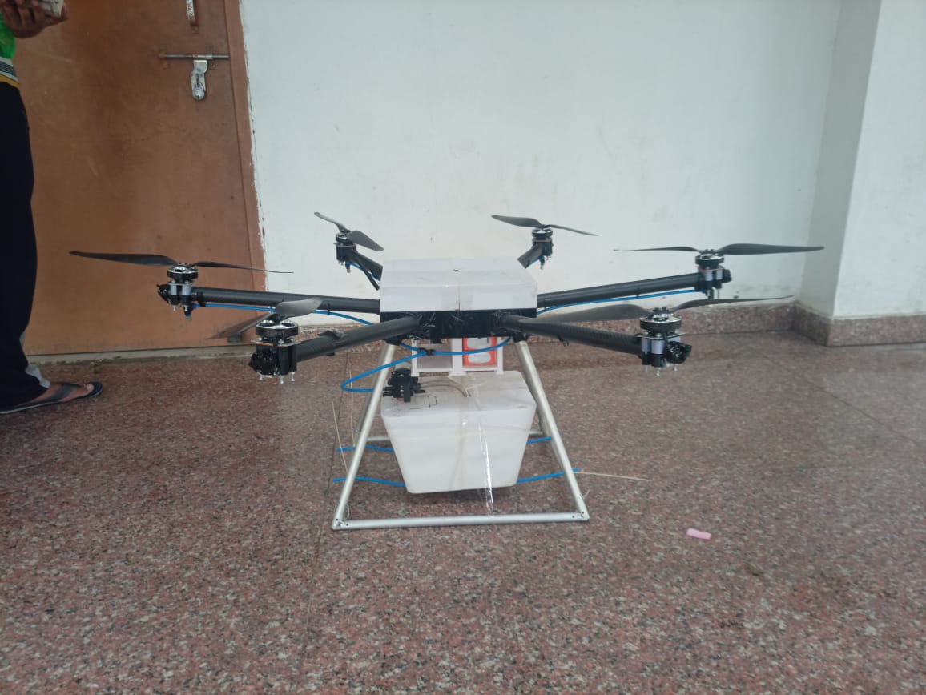
About the Project
The project named “DRONEHOUSE” is online drone shopping and its parts selling site,people will first have to create an account and then they will be able to share their ideas and discuss their point of views and objectives on various topics regarding technologies.this ful fledged front end website.
People can also contact our expert to learn these aeriel technologies.
Quad
Drone…

Slide 6

Expert says…

Slide 7
Primary reason to choose this Project
We chose "DRONEHOUSE “ as our project because we wanted to students to learn about drones and wants to provide information regarding drones and their parts as we know drones are so coastly so we trying our best to recognize this field.

Slide 8
Major Requirements
1. web design
2.content
3.text
4.images
5. coding
6. hosting through github
7.html,css,bootstrap
8. github
9.pixabay

Slide 9
Things we have done so far
So far , we have provided the front end to our website with one google form on it at contact bar , we have used HTML5 for tagging and css for image implementation.
In this we have used a scripting language “Javascript” to provide the functioning to this web application.
We have also showed the real images of drones which are made by our experts.

Slide 10
Things we are going to do …
We are going to add backend to our website and we are going to provide a large data to it. Like a person can simply shop , learn and sell aeriel technologies within our site.

Slide 11
Scope of the Project
Our Scope is to develop an appealing Frontend with easy to understand of user Interface and a comfortable user experience with working user input like shopping , email login , page information for drone activities. Currently we are at initial stage of our project , we would highly like to extend the project on higher scale.

Slide 12
references
Quora
Aeromodelling club
pixabay
MDN
Bootstrap.com
Google docs

Slide 13
Collaboration
We would like to share that we are going to collaborate with AEROMODELLING club, GLAU ( which is tech based club making drones and other droids), their experts will be guiding our drone learners
We shall be collaborating with ROBOSOC society of NIIT, HAMIRPUR , soon as they are specialized in droid workings and one of the largest robot society.

Slide 14
Scope of the Project
Our Scope is to develop an appealing Frontend with easy to understand of user Interface and a comfortable user experience with working user input like shopping , email login , page information for drone activities. Currently we are at initial stage of our project , we would highly like to extend the project on higher scale.

Slide 15
Website (links)
Website link : http://127.0.0.1:5500/dronehouse/online_shop-main/index.html#contact
Google form link : https://docs.google.com/forms/d/1RrKmPG3bxzJIU1gjNjXA0sb8RVuo3rWXMM0fiSWDDgY/prefill
Github link : https://github.com/Jayantbhardwaj00000/drone.github.io

Slide 16
THANKYOU !
.

